Slide 1
Software Estimation

Slide 2













Slide 3


Using the Cocomo 81 model
This begins with an educated guess at how many lines of code are required to program a particular piece of functionality.
E.g. to program a simple calculator of wages, taxes and other deductions might require 12000 lines of code. Assuming we are using COBOL. I have about 45 employees.
It is a standalone, i.e. it does not integrate with any other system.

Slide 4

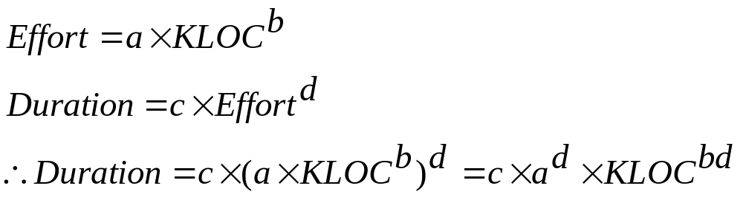
Organic: Standalone applications such as classical, non-web enabled word-processors.
Semidetached: In between.
Embedded: Integral to hardware and software systems.
Software project | a | b | c | d
Organic | 2.4 | 1.05 | 2.5 | 0.38
Semidetached | 3.0 | 1.12 | 2.5 | 0.35
Embedded | 3.6 | 1.20 | 2.5 | 0.32

Slide 5





Slide 6











Slide 7










Slide 8





Slide 9
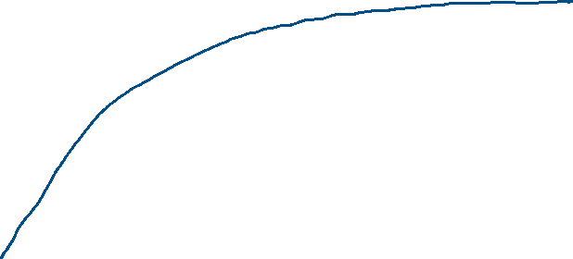




The mythical person-month

Slide 10
Difficult task
Simplest methods based on source lines of code (LOC) often expressed as thousands of lines of code (KLOC).
LOC seems to be of less importance as productivity tools improve and languages become more productive.
While estimation methods based on LOC have noted flaws, significantly better methods have not been widely reported.

Slide 11
Lines of code
Basis: The amount of time required to develop a set of code is a function of its size.
Begins with gathering historical records of experiences of past projects. The historical data are the basis for identifying the relationship between key measures of importance , e.g.:
  person-months of effort
  money expended
Other factors include:
  Pages of documentation generated
  Errors encountered
  System defects
  People assigned

Slide 12
Lines of code
For a new project an estimate of the number of lines is made. E.g. 10000 lines.
Effort | 1.606 x 10000 LOC = 16 person-months
Budget | 15.673 x 10000 LOC = R157 000
Documentation | 58.122 x 10000 LOC = 581 pages
Errors | 9.784 x 10000 LOC = 98
Defects | 2.531 x 10000 LOC = 25
People | 0.195 x 10000 LOC = 2 people

Slide 13
Lines of code
The method is rough but provides a simple to implement approach.

Slide 14
Function Point Analysis
Albrecht’s function point (FP) analysis method supplements project size bases of estimation. The approach aims to provide a consistent meaningful measure with rules that are easy to apply.
Can be used to estimate cost and time based on requirements specifications, and is independent of the technology used.
It has been strongly criticized for questionable weightings, alternate counting methods and underweighting of large systems. However some consider it to be more useful than the LOC method.

Slide 15
Function Point Analysis
Works in a manner similar to LOC, except the basis for estimation is function points (reflecting in essence work to be done). The original presentation of the method involved counts of the number of activities in five categories:
  User inputs
  User outputs
  User inquiries
  Files accessed
  External interfaces
The number of functions are counted by complexity level for each factor and multiplied as in the following table.

Slide 16
Function Point Analysis
 | Complexity Weighting
Measurement parameter | Low | Average | High | Product
Number of user inputs | ____ x 3 + | ____ x 4 + | ___ x 6 + = | ________
Number of user outputs | ____ x 4 + | _____ x 5 + | ___ x 7 + = | _______
Number of user inquiries | _____ x 3 + | _____ x 4 + | ___ x 6 + = | ________
Number of files | _____ x 7 + | ____ x 10 + | ___ x 15 + = | ______
Number of external interfaces | _____ x 5 + | _____ x 7 + | ____ x 10 + = | _______

Slide 17
Function Point Analysis
 | Complexity Weighting
Measurement parameter | Low | Average | High | Product
Number of user inputs | __6__ x 3 + | ___5__ x 4 + | __7_ x 6 + = | ____80____
Number of user outputs | ____ x 4 + | ___5__ x 5 + | ___ x 7 + = | ______25__
Number of user inquiries | _____ x 3 + | __6___ x 4 + | ___ x 6 + = | ____24____
Number of files | ___8__ x 7 + | ____ x 10 + | __ x 15 + = | ______56__
Number of external interfaces | _____ x 5 + | _____ x 7 + | __7 x 10 + = | ___70_____

Slide 18

F1 | Does the system require reliable backup and recovery? |  | 0
F2 | Are data communications required? |  | 3
F3 | Are there distributed processing functions? |  | 0
F4 | Is performance critical? |  | 5
F5 | Will the system run in an existing, heavily utilized operational environment? |  | 0
F6 | Does the system require online data entry? |  | 0
F7 | Does the online data entry require the input transaction on multiple screens or operations? |  | 0
F8 | Are the master files updated online? |  | 5
F9 | Are the inputs, outputs, files or inquiries complex? |  | 4
F10 | Is the internal processing complex? |  | 5
F11 | Is the code designed to be reusable? |  | 0
F12 | Are conversion and installation included in the design? |  | 0
F13 | Is the system designed for multiple installations in different organizations? |  | 0
F14 | Is the application designed to facilitate change and ease of use by the user? |  | 0
 |  | Total | 22

Slide 19

Function Point Analysis
A 0 to 5 scale is used for these 14 factors:
  0 no effect
  1 incidental
  2 moderate
  3 average
  4 significant
  5 essential effect
Function points are calculated using the following formula:

Slide 20


Slide 21





Slide 22







Slide 23



Slide 24
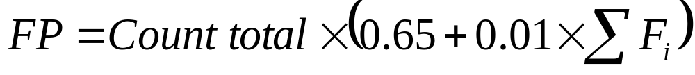






Slide 25
Average of past projects: | Effort | R(000) | pp. Doc. | Errors
LOC 12500 FP 600 | 12 months | 521 | 300 | 45

Slide 26
Function Point Estimation
Use of the FP value is based on averages of past projects (regression?)
Function Points: Calculate FP, multiply averages by FP.
I.e. Average per FP from past projects, Effort, Budget, Documentation, Errors, Defects, People

Slide 27
Many other software estimation models have been developed. However, many are proprietary models and cannot be readily compared and contrasted in terms of the model structure. Theory or experimentation determines the functional form of these models.

Slide 28
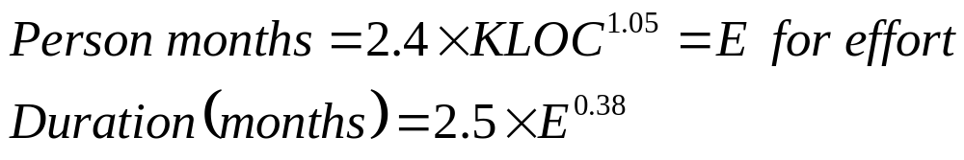
(Constructive Costing Model)
COCOMO
Now considered to be obsolete
The Basic COCOMO computes software development effort based on program size.
An intermediate model also considers a set of cost drivers reflecting specific product, hardware, personnel, and project characteristics.
For relatively small, simple software projects built by small teams with good experience, COCOMO formulas for person-months of effort and development time in chronological months are as follows:

Slide 29
COCOMO ‘81 Intermediate Model
Constructive Costing Model
Where KLOC means thousand lines of code.
There are variations of COCOMO in current use.
It is possible for organizations to generate their own using regression on productivity data.
While the COCOMO approach is not perfectly accurate in many conditions, it nevertheless provides a useful starting basis for projects oriented around work that can be described in terms of lines of code generated.

Slide 30

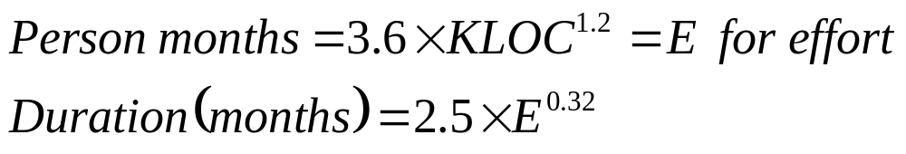
For software projects of intermediate size and complexity, built by teams with mixed experience and facing more rigid than average requirements the formulas are modified as follows:
Finally, for a software project built under rigid conditions, the formulas are as follows:

Slide 31
COCOMO Cost Drivers
COST DRIVER | DESCRIPTION
RELY | Required software reliability
DATA | Database size
CPLX | Product complexity
TIME | Execution time constraints
STOR | Main storage constraints
VIRT | Virtual machine volatility - degree to which the operating system changes
TURN | Computer turn around time
ACAP | Analyst capability
AEXP | Application experience
PCAP | Programmer capability
VEXP | Virtual machine (i.e. operating system) experience
LEXP | Programming language experience
MODP | Use of modern programming practices
TOOL | Use of software tools
SCED | Required development schedule

Slide 32




How to use the Intermediate Cocomo ‘81 model?
We imagine we are developing an application that we believe needs 12000 lines of code to complete.
It is an organic project.
Our developers are very highly capable.
Our database is very large.

Slide 33
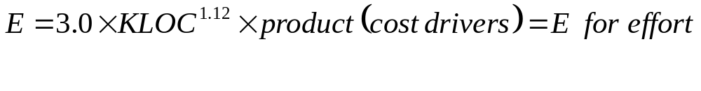
COCOMO Cost Driver Values
COCOMO - COST DRIVERS
 |  |  | RATING
 | COST DRIVER |  | V.LOW | LOW | NOMINAL | HIGH | V.HIGH | EX. HIGH
(PRODUCT) | RELY |  | 0.75 | 0.88 | 1.00 | 1.15 | 1.40 | .
.. | DATA |  | . | 0.94 | 1.00 | 1.08 | 1.16 | .
.. | CPLX |  | 0.70 | 0.85 | 1.00 | 1.15 | 1.30 | 1.65
(COMPUTER) | TIME |  | . | . | 1.00 | 1.11 | 1.30 | 1.66
.. | STOR |  | . | . | 1.00 | 1.06 | 1.21 | 1.56
.. | VIRT |  | . | 0.87 | 1.00 | 1.15 | 1.30 | .
.. | TURN |  | . | 0.87 | 1.00 | 1.07 | 1.15 | .
(PERSONNEL) | ACAP |  | 1.46 | 1.19 | 1.00 | 0.86 | 0.71 | .
.. | AEXP |  | 1.29 | 1.13 | 1.00 | 0.91 | 0.82 | .
.. | PCAP |  | 1.42 | 1.17 | 1.00 | 0.86 | 0.70 | .
.. | VEXP |  | 1.21 | 1.10 | 1.00 | 0.90 | . | .
.. | LEXP |  | 1.14 | 1.07 | 1.00 | 0.95 | . | .
(PROJECT) | MODP |  | 1.24 | 1.10 | 1.00 | 0.91 | 0.82 | .
.. | TOOL |  | 1.24 | 1.10 | 1.00 | 0.91 | 0.83 | .
.. | SCED |  | 1.23 | 1.08 | 1.00 | 1.04 | 1.10 | .

Slide 34
In Summary
Organic: Standalone applications such as classical, non-web enabled word-processors.
Semidetached: In between.
Embedded: Integral to hardware and software systems.
Software project | a | b | c | d
Organic | 2.4 | 1.05 | 2.5 | 0.38
Semidetached | 3.0 | 1.12 | 2.5 | 0.35
Embedded | 3.6 | 1.20 | 2.5 | 0.32

Slide 35
The difference between the basic Cocomo model and the intermediate is in the use of cost drivers
The basic model does not use cost drivers
The intermediate model uses up to 15 cost drivers.

Slide 36
So, one way to estimate Cost and Duration very early in a project
  Use function point method to estimate lines of code.
  Use Boehm’s COCOMO formulas to estimate labour required.
  User and labour estimate and Boehm’s formulas to estimate duration.

Slide 37
Boehm’s duration formula is independent of the number of people put on the job. It depends only on the size of the job. It assumes that the project will have roughly an appropriate number of people available to it at any given time.
The model has been tested extensively and is widely recognized, and has been refined over time. However, a great deal of practice is required to use it effectively. It has probably best used along with an independent method and a healthy dose of common sense.

